Slide 1
SUBALTERN SCHOOL
SUMAN PATRA
ASSISTANT PROFESSOR
DEPARTMENT OF HISTORY
CHANDIDAS MAHAVIDYALAYA

Slide 2
Subaltern Studies
The Subaltern Studies Group (SSG) or Subaltern Studies Collective is a group of South Asian scholars interested in the postcolonial and post-imperial societies which started at the University of Sussex in 1979–80.
The term "subaltern" in this context is an allusion to the work of Italian Marxist Antonio Gramsci (1891–1937).
The term's semantic range has evolved from its first usage by Ranajit Guha, following Gramsci, to refer solely to peasants who had not been integrated into the industrial capitalist system. It now refers to any person or group of inferior rank or station, whether because of race, class, gender, sexual orientation, ethnicity, or religion.

Slide 3
FEATURES
Their essentialist approach is one of history from below, focused more on what happens among the masses at the base levels of society than among the elite.

Slide 4
The SSG arose in the 1980s, influenced by the scholarship of Eric Stokes and Ranajit Guha, to attempt to formulate a new narrative of the history of India and South Asia.
This narrative strategy most clearly inspired by the writings of Gramsci was explicated in the writings of their "mentor" Ranajit Guha, most clearly in his "manifesto" in Subaltern Studies I and also in his classic monograph The Elementary Aspects of Peasant Insurgency. Although they are, in a sense, on the left, they are very critical of the traditional Marxist narrative of Indian history, in which semi-feudal India was colonized by the British, became politicized, and earned its independence.
In particular, they are critical of the focus of this narrative on the political consciousness of elites, who in turn inspire the masses to resistance and rebellion against the British.
Instead, they focus on non-elites — subalterns — as agents of political and social change.

Slide 5
Scholars associated with Subaltern Studies include:
Ranajit Guha
Eric Stokes
David Arnold
David Hardiman
Dipesh Chakrabarty
Partha Chatterjee
Gyanendra Pandey
Gyan Prakash
Sumit Sarkar (later dissented)
Gayatri Chakravorty Spivak
Gautam Bhadra
Shahid Amin

Slide 6
Criticism
One of the group's early contributors, Sumit Sarkar, later began to critique it. He entitled one of his essays "Decline of the Subaltern in Subaltern Studies", criticizing the turn to Foucauldian studies of power-knowledge that left behind many of the empiricist and Marxist efforts of the first two volumes of Subaltern Studies. He writes that the socialist inspiration behind the early volumes led to a greater impact in India itself, while the later volumes' focus on western discourse reified the subaltern-colonizer divide and then rose in prominence mainly in western academia.
Even Gayatri Spivak, one of the most prominent names associated with the movement, has called herself a critic of "metropolitan post-colonialism".^{[6]}

Slide 7
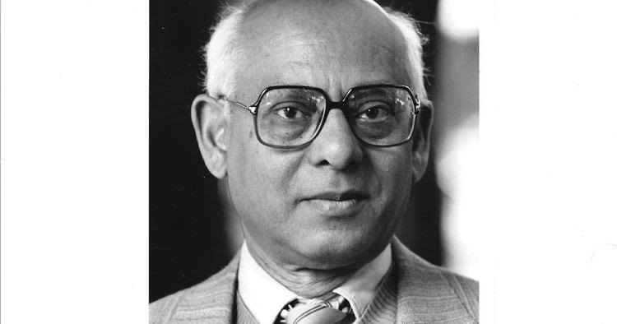
RANAJIT GUHA

Slide 8
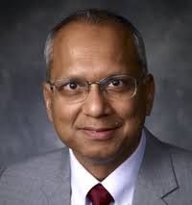
SUMIT SARKAR

Slide 9
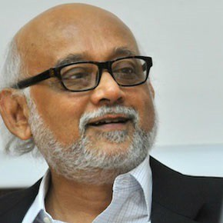
PARTHA CHATTERJEE

Slide 10
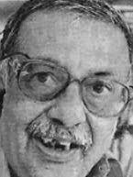
GAUTAM BHADRA

Slide 11
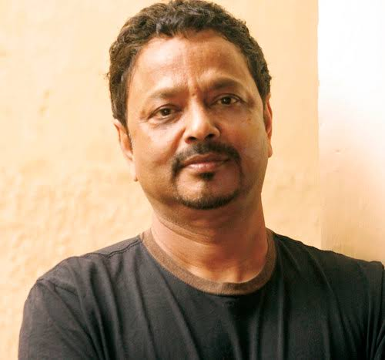
GYAN PRAKash

Slide 12
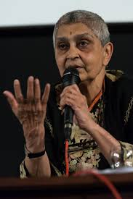
GAYATRI CHAKRABARTY SPIVAK

Slide 13
Thank You

